Slide 1

Digital Transformation of HR Processes for Tawsila Shipping Company
In today's rapidly evolving shipping industry, adopting digital transformation is no longer a choice but a necessity. This presentation explores how a shipping company can leverage Oracle solutions to streamline and optimize its HR processes, leading to a more efficient, secure, and data-driven approach to managing its workforce.

Slide 2

Why Digital Transformation is Crucial for Shipping Companies
Enhanced Efficiency and Productivity
Improved Customer Service
Digital tools enable faster and more accurate communication, improving responsiveness to customer inquiries and needs.
Automated processes and real-time data analysis streamline operations, reducing errors and increasing efficiency.
Increased Competitiveness
Data-Driven Decision Making
Digital transformation allows companies to adapt quickly to changing market conditions and gain a competitive edge.
Access to real-time data empowers informed decision-making based on accurate insights and analysis.

Slide 3

Implementation Roadmap and Key Takeaways
1
Needs Assessment
Identify current HR processes and challenges.
2
Solution Selection
Choose the best Oracle HR solution for the company's needs.
3
Implementation Planning
Develop a detailed implementation plan with timelines and resources.
4
System Configuration
Customize Oracle HR system to meet the specific requirements.
5
User Training
Train employees on the new HR system and processes.
6
Go-Live and Ongoing Support
Launch the system and provide ongoing support to users.

Slide 4

Challenges with Current HR Processes
Paper-Based Systems
Data Silos
Manual paperwork and processes are inefficient, prone to errors, and difficult to manage for a geographically dispersed workforce.
Lack of a centralized HR system leads to data silos, making it challenging to access and analyze employee information.
Limited Analytics Capabilities
Complex Onboarding and Training
Without robust data analytics, HR decision-making relies on intuition and gut feelings rather than data-driven insights.
Manual onboarding and training processes can be lengthy and cumbersome, leading to delays in employee integration and productivity.

Slide 5
Overview of Oracle HR Solutions
Oracle Cloud HCM
Oracle Fusion HCM
Oracle Cloud HCM is a comprehensive, cloud-based solution that provides a wide range of HR functionality, including talent management, payroll, and benefits administration. This solution is ideal for companies with a global workforce, as it can be customized to meet the specific needs of different countries and regions.
Oracle Fusion HCM is an on-premises solution that offers a more traditional approach to HR management. It provides a robust set of features that can be customized to meet the specific needs of a shipping company. This solution is well-suited for companies with a large IT infrastructure and a preference for on-premises solutions.
For example, Oracle Cloud HCM can help a shipping company track employee time and attendance across multiple locations, ensuring compliance with local labor laws and regulations. It also offers advanced analytics capabilities to monitor employee performance and identify areas for improvement.
For example, Oracle Fusion HCM can help a shipping company manage its employee benefits and retirement plans. It also provides comprehensive reporting and analytics capabilities, allowing HR managers to gain valuable insights into their workforce.

Slide 6
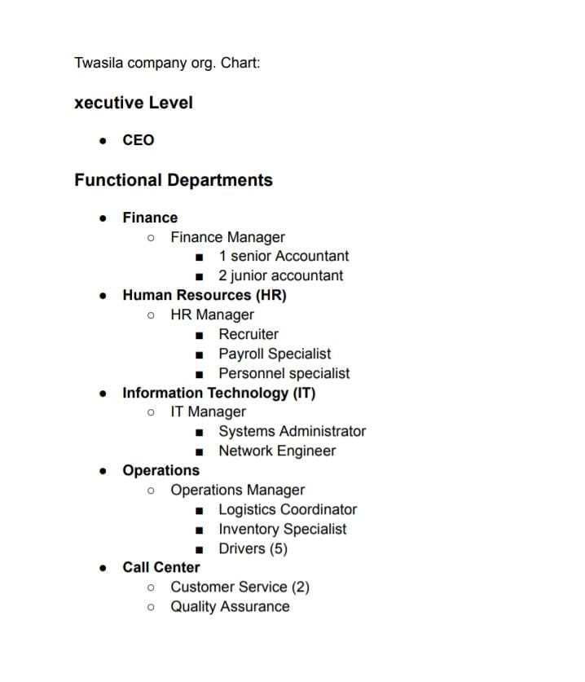
Twasila Company Organizational Chart

Slide 7

Creating the Business Group
Define Scope
Establish Roles
Clearly define the purpose and boundaries of the business group within the shipping company.
Identify key roles and responsibilities within the business group, aligning with company goals.
Allocate Resources
Assign appropriate resources, including personnel, budget, and technology, to support group operations.

Slide 8
Establishing Locations
Location Data
Location Hierarchy
Location Management
Capture accurate and comprehensive data about each location, including addresses, contact information, and any relevant geographical details.
Establish a clear hierarchy of locations, grouping them based on their relevance to operations, such as regional hubs, ports, or distribution centers.
Implement tools for managing location data effectively, enabling easy updates, analysis, and reporting on key location information.

Slide 9




Defining Departments and Sections
Department Creation
Establish key departments aligned with the shipping company's core functions, such as operations, logistics, finance, and human resources.
Section Organization
Divide departments into specialized sections, such as transportation, warehousing, customer service, or accounting, to enhance focus and efficiency.
Workflow Integration
Define clear workflows and processes within each department and section to ensure smooth operation and collaboration.

Slide 10
Defining Positions, Grades, and Jobs
Position Creation
1
Establish a comprehensive list of positions within the shipping company, ensuring all necessary roles are accounted for.
Grade Structure
2
Implement a clear grade structure, assigning positions to appropriate levels based on responsibilities and experience.
Job Descriptions
3
Develop detailed job descriptions for each position, outlining responsibilities, qualifications, and reporting relationships.

Slide 11

Constructing the Organizational Hierarchy
1
Role Definition
Clearly define the roles and responsibilities of each position within the hierarchy, ensuring clarity and accountability.
2
Reporting Structure
Establish clear reporting lines, identifying who reports to whom, to optimize communication and decision-making.
3
Span of Control
Determine the appropriate number of direct reports for each manager, balancing efficiency and effective supervision.
4
Decision-Making Authority
Define the level of decision-making authority for each position, empowering employees and promoting accountability.

Slide 12
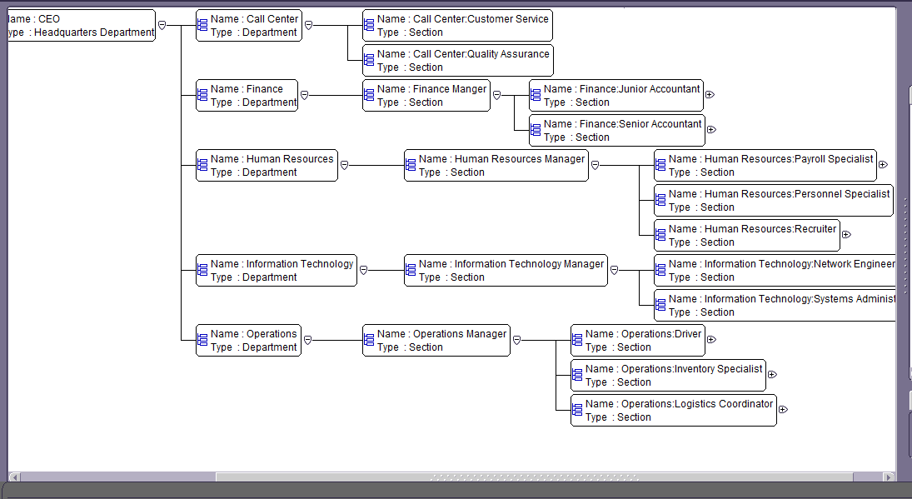
Twasila Company Organizational Chart
The Twasila Company organizational chart represents the company's structure and its key departments. It is a hierarchical chart that depicts the flow of authority from the CEO down to the various departments and their respective roles. This chart provides a clear visual overview of the company's structure and its different roles and responsibilities.

Slide 13




Assigning Payroll to Employees
Employee Data
Import employee data into the Oracle payroll system, ensuring accurate information about each employee, including their personal details, job title, and salary.
Payroll Information
Configure the payroll system to accurately calculate and distribute pay based on employee data, including taxes, benefits, and deductions.
Payroll Assignment
Assign each employee to the appropriate payroll cycle, determining the frequency of their paychecks and the payment method.

Slide 14

Entering Payroll Elements
Basic Salary
Tax Information
Enter the employee's base salary, including any potential overtime or bonus structures.
Input the employee's tax details, such as withholding allowances and tax rates, to ensure accurate tax deductions.
Benefits and Deductions
Other Payments
Specify any benefits and deductions the employee is eligible for, such as health insurance, retirement contributions, or loan payments.
Include any additional payments or reimbursements, such as travel expenses or reimbursements for work-related purchases.

Slide 15
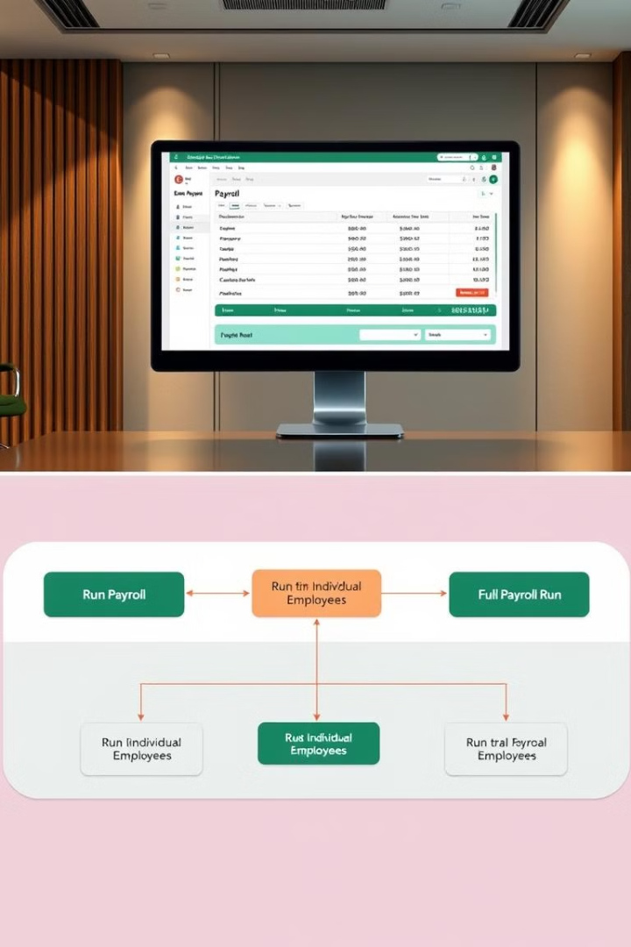
Running Payroll for Individual Employees and Conducting Full Payroll Runs
100%
99%
Payroll Accuracy
Time Savings
Ensuring precise calculations and timely disbursement of employee wages.
Automating payroll processes to reduce manual effort and processing time.
80%
$50K
Compliance Adherence
Cost Reduction
Meeting all relevant labor laws and tax regulations.
Lowering administrative costs associated with manual payroll operations.

Slide 16
Team Members
1
2
Hager Samir Ahmed
3
Hasnaa AbdElghany Ali
4
6
Amira Tarek Ibrahim
5
Katreen Ashraf Nady
Omnya Hassan Mohamed
Yara Khaled Fawzy

